Slide 1
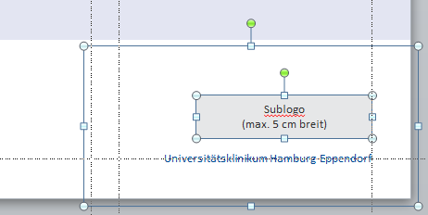
New Project
Research
Die Möglichkeit, ein Sublogo zu platzieren, haben Sie auch auf den anderen Titelseiten-Layouts.
Markieren Sie sich hierzu alle Elemente in der unteren rechten Ecke und kopieren Sie sie mit STRG+C.
Gehen Sie auf eines der anderen Titel-Layouts und drücken Sie STRG+V, um die Elemente an gleicher Stelle einzufügen.
Markieren Sie dann das rote Hinweisfeld an der oberen rechten Ecke und löschen es.
(Maximilian Schulz | 19.08.2021)
Universitätsklinikum Hamburg-Eppendorf

Slide 2
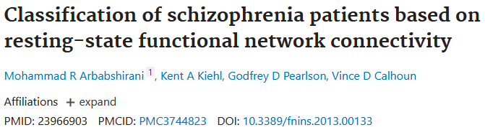

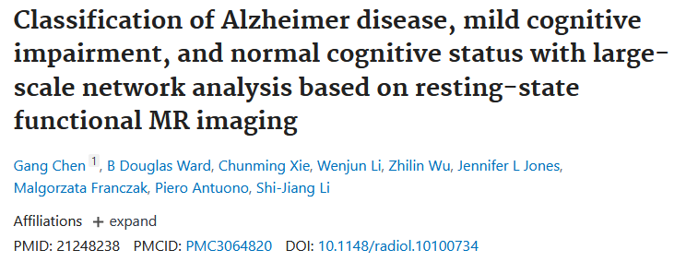

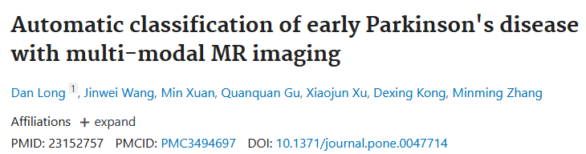

Slide 3

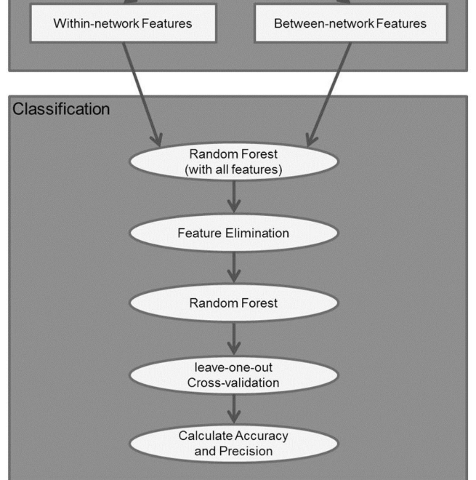
Machine-learning algorithms provide alternative tools to look into multivariate patterns in the data with between and within network connectivity
Sought to identify connectivity features in a multivariate fashion that are predictive of alcohol dependence
a) Whether rs-FC features are able to distinguish between AUD and controls; b) Which brain-based features are able to diagnose and are potentially predictive of alcohol dependence? and c) Can we quantify how well they identify AUD and what are the best neuronal predictors of AUD?
46 controls and 46 AUDs. Both within-network connectivity for each network and between-network connectivity for each pair of networks were used as features. Random forest was applied for pattern classification.
The results showed that within-networks features were able to identify AUD and control with 87.0% accuracy and 90.5% precision. Networks that were most informative: Executive Control Networks (ECN), and Reward Network (RN). The between-network features achieved 67.4% accuracy and 70.0% precision. The between-network connectivity between RN-Default Mode Network (DMN) and RN-ECN contribute the most to the prediction.

Slide 4
Global/local efficiency
Path length
Segregation global
Within network connecitivity
Structural connectivity
Modularity
Structural network features
Functional network features
Between network connecitivity
Segregation association networks
We showed that the rs-FC features are able to automatically discriminate elderly from mid-age.
We quantitatively compared the performance of structural and functional features that contribute most to the classifier and identified the features best detecting elderly subjects.
Our results showed that the structural features distinguish elderly from mid-age with 87% accuracy and 90.5% precision, higher than the performance using functional features (67.4% accuracy and 70.0% precision) especially within DMN and Salience Segregation.
Segregation sensory networks
Random Forest (all features)
Feature Elimination
Morbus Crohn
Allergies
Hormon treatment
Schlafapnoe
COPD
Paradontitis
Cross validation
Accuracy and Precision
Ability to handle highly non-linear biological data, robustness to noise, tuning simplicity (compared to other ensemble learning algorithms), and opportunity for efficient parallel processing

Slide 5
Conclusions
We identified network-level brain features of aging, and further quantified functional resting-state networks, and structural connectivity features in a multivariate fashion that are classifying aging, thus providing additional information about how each network contributes to degeneration in age.
Quantify large-scale structural and functional network differences and offer new insights into the identification of potential biomarkers for the clinical aging
We observed that within-network segregation measures offered maximal information for identifying elderly brains, suggesting that connectivity measures within the DMN and the Salience network are particularly informative in detecting effects of age on the brain. The classification performance improved with feature elimination suggesting that these few networks performed outstandingly among all other networks.

Slide 6
Random Forest
Two levels of randomness: first each tree uses a bootstrapped version of the training data (bagging). About 66% of the training data was used for each tree with replacement; the remaining training data was used to estimate error and variable importance.
A second level of randomness is added at each node when growing a decision tree by randomly selecting a subset of variables to split. At each internal node, a best feature among a random subset of features is selected so as to maximize the reduction of label impurity, typically measured with the class entropy
The process is recursively repeated until the tree has either reached a predefined depth or the number of samples in a node falls below a threshold, or all the samples belong to the same class. The number of trees in the ensemble and the number of variables selected at each node are the two main parameters of the random forest algorithm.
Classification of a new instance can be made by taking the majority vote from all the decision trees
constructing variable importance: mean decrease impurity, i.e. average of the accumulated decrease in node impurity over all trees for each feature

Slide 7
Feature elimination
Total number of variables is large, but the fraction of relevant variables is small, then random forests are likely to perform poorly due to the small chances that the relevant variables being selected.
The dimensionality of feature space increases, the available observations become sparse which causes the problem of “curse of dimensionality” which refers to the phenomenon that as dimensionality of data increases, the available data becomes sparse, thus it is difficult to extract a meaningful conclusion from the data set.
Random forest can be considered as an effective feature selection algorithm by using the feature importance scores. In the current study, random forest was first performed on all features, and the ranking of average feature importance was used for feature elimination.

Slide 8
Classification performance
Performance of the classifier was then evaluated based on accuracy, and precision. The prediction data included true positive (TP), false negative (FN), true negative (TN), and false positive (FP) classifications.
Accuracy = (TP + TN)/(TP + TN + FP + FN) ∗ 100%
Precision (Sensitivity) = TP/(TP + FP) ∗ 100%
To explore an optimal set of feature variables, datasets were entered individually, and the prediction accuracy was computed by using leave-one-out cross-validation (LOOCV).
One subject’s data are left out of the dataset, and the random forest creates an optimal classifier using the remaining data. The classifier predicts the label (AUD or control) of the one subject who was left out, and the accuracy of this prediction is assessed. This procedure was repeated as many times as the number of subjects, with a different subject being left out each time; finally, total accuracy was computed for each category
To test whether classification performance was significantly above chance, we randomly assign each subject as AUD or control and used this dataset to train and test each classifier. This

Slide 9
Random forest, an ensemble machine-learning algorithm, builds a group of weak learners of decision trees to form a “strong learner”, thereby improving the generalization ability of the classifier
Two levels of randomness: first each tree uses a bootstrapped version of the training data (bagging). Specifically, about 66% of the training data was used for each tree with replacement; the remaining training data was used to estimate error and variable importance.
A second level of randomness is added at each node when growing a decision tree by randomly selecting a subset of variables to split. At each internal node, a best feature among a random subset of features is selected so as to maximize the reduction of label impurity, typically measured with the class entropy. The process is recursively repeated until the tree has either reached a predefined depth or the number of samples in a node falls below a threshold, or all the samples belong to the same class.
mportant advantages over other techniques in terms of its ability to handle highly non-linear biological data, robustness to noise, tuning simplicity (compared to other ensemble learning algorithms), and opportunity for efficient parallel processing [18].
Classification of a new instance can be made by taking the majority vote from all the decision trees. It’s often helpful to calculate relative importance or contribution of each feature in predicting the label.

Slide 10
1) mean decrease impurity, i.e. average of the accumulated decrease in node impurity over all trees for each feature
mean decrease accuracy, i.e. the decrease in accuracy on out-of-bag (OOB) samples by randomly permuting values for each feature.
python package scikit random forest [19]
Feature elimination
total number of variables is large, but the fraction of relevant variables is small, then random forests are likely to perform poorly due to the small chances that the relevant variables being selected.
In the current study, random forest was first performed on all features, and the ranking of average feature importance was used for feature elimination
performance of the classifier was then evaluated based on accuracy, and precision. The prediction data included true positive (TP), false negative (FN), true negative (TN), and false positive (FP) classifications.

Slide 11

Classification performance
The performance of the classifier was then evaluated based on accuracy, and precision. The prediction data included true positive (TP), false negative (FN), true negative (TN), and false positive (FP) classifications
To explore an optimal set of feature variables, datasets were entered individually, and the prediction accuracy was computed by using leave-one-out cross-validation (LOOCV). I

Slide 12
Klinik, Institut, Geschäftsbereich
Martinistraße 52 | D-20246 Hamburg
Ansprechpartner
Telefon +49 (0) 15202781606 m.schulz1@uke.de | www.uke.de

